Slide 1
Group Discussion (GD)
Objectives and Methods

Slide 2
Introduction
Group Discussion (GD) is a method of assessing communication, teamwork, and problem-solving skills.
Widely used in education, recruitment, and professional development.
A group discussion (GD) is a formal, structured conversation where a group of people discuss a given topic, aiming to evaluate communication, reasoning, leadership, and teamwork skills. Unlike a debate, it is a cooperative process where participants can express both for and against arguments, working toward a collective consensus rather than a competitive win. GDs are used in admissions, scholarships, and job interviews to assess an individual's overall personality and suitability in a group setting.

Slide 3
Objectives of Group Discussion
Evaluate communication & expression
Assess teamwork & leadership
Test problem-solving & decision-making
Judge listening & interpersonal skills
Encourage exchange of ideas

Slide 4
Purpose of a Group Discussion
Assess Skills:
To evaluate candidates' communication, leadership, problem-solving, analytical, and decision-making skills.
Evaluate Personality:
To understand a person's thoughts, feelings, and behavior in a group environment.
Promote Teamwork:
To observe how individuals collaborate, respect diverse viewpoints, and contribute to a cooperative atmosphere.

Slide 5
Key Characteristics
Topic-Based: A specific topic or issue is presented for discussion.
Interactive: Participants sit together and exchange ideas in an organized, oral manner.
Cooperative: The goal is to reach a mutual understanding or consensus, not to win against others.
Observational: A panel of observers (panellists or interviewers) monitors the discussion to assess participants.

Slide 6
Skills Tested
Communication: Clear articulation of ideas, active listening, and coherent speaking.
Leadership: Guiding the discussion, encouraging participation, and maintaining order.
Critical Thinking: Analyzing the topic, structuring arguments, and generating relevant points.
Teamwork: Working effectively with others, showing respect for different opinions, and contributing to group goals.
Subject Knowledge: Demonstrating understanding and relevant information about the given topic.

Slide 7
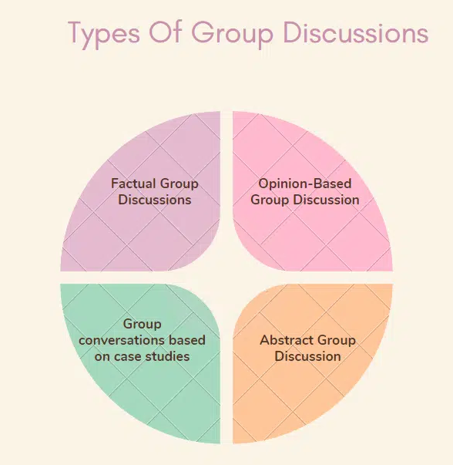
The Types Of Group Discussions

Slide 8
1. Factual Group Discussions
These discussions revolve around concrete facts and information. The participants need to grasp the topic well and present accurate data and evidence to support their viewpoints.
Example Topics: “The Impact of Global Warming,” “Advancements in Renewable Energy,” and “Current Economic Trends.”
Skills Assessed: Research abilities, knowledge of the subject, and the ability to present facts.
2. Opinion-Based Group Discussions
In these discussions, participants express their views and opinions on a given topic. There is no right or wrong answer; the focus is on how well participants can argue their perspectives and engage with differing viewpoints.
Example Topics: “Is Social Media Beneficial or Harmful?”, “The Role of Technology in Education,” “Ethics in Business.”
Skills Assessed: Critical thinking, persuasive communication, and the ability to handle opposing opinions.

Slide 9
3. Group Conversations Based on Case Studies
Participants are given a scenario or a case study to discuss and analyze. They must work together to identify problems, evaluate options, and propose solutions.
Example Topics: “A company’s marketing strategy failing,” “A healthcare policy impacting patient care,” “Resolving a workplace conflict.”
Skills Assessed: Analytical skills, problem-solving, teamwork, and practical application of knowledge.
4. Abstract Group Discussions
These discussions are based on abstract concepts or philosophical ideas. Participants need to interpret the topic creatively and think outside the box.
Example Topics: “Red vs. Blue,” “A Journey Without a Destination,” “Time is Money.”
Skills Assessed: Creativity, abstract thinking, and innovatively linking ideas and concepts.

Slide 10
Essential Skills Evaluated During a Group Discussion
1. Subject Expertise
Depth of Knowledge: Demonstrating a comprehensive understanding of the topic. This involves being well-informed and up-to-date with relevant facts, theories, and examples.
Accuracy and Relevance: Providing accurate and pertinent information to support your arguments. It’s essential to avoid spreading misinformation or going off-topic.
2. Creativity and Originality
Innovative Thinking: Introducing unique perspectives and fresh ideas others may not have considered. Creativity in approach can differentiate you from other participants.
Problem-Solving: Applying creative solutions to the issues discussed. This skill showcases your ability to think outside the box and approach problems from various angles.
3. Voice
Clarity: Ensuring your speech is clear and easily understandable. Articulation and pronunciation play a significant role in how your points are received.
Tone and Modulation: Use the appropriate tone to convey your message effectively. Voice modulation can help emphasize key points and keep the audience engaged.
4. Bodily Language
Gestures and Posture: Use positive body language to reinforce your verbal communication. Good posture, appropriate hand gestures, and nodding convey confidence and attentiveness.
Eye Contact: Maintaining eye contact with fellow participants and the moderator to demonstrate confidence and engagement. Avoiding eye contact can be perceived as disinterest or nervousness.

Slide 11
Essential Skills Evaluated During a Group Discussion
5. Fluency
Smooth Delivery: Speaking fluently without unnecessary pauses, fillers, or hesitations helps maintain the flow of the discussion and keeps the audience engaged.
Language Proficiency: Using appropriate vocabulary and grammar to express your ideas clearly and effectively. Mastery of language enhances your credibility and the impact of your contributions.
6. Initiative
Proactiveness: Taking the lead when necessary by starting the discussion, introducing new points, or steering the conversation back on track if it diverges.
Encouraging Participation: Facilitating a balanced discussion by encouraging quieter members to share their views and ensuring that all voices are heard.
7. Active Listening
Attention: Paying close attention to others’ contributions shows respect and interest. Active listening involves nodding, summarizing points, and asking clarifying questions.
Responsive Interaction: Responding thoughtfully to others’ ideas, building on their points, and respectfully countering when necessary. This skill demonstrates your ability to engage constructively with different viewpoints.

Slide 12
Expert Tips On How to Succeed in Group Discussions
1. Understand the Topic
Research Thoroughly: Gather as much information as possible about the topic before the discussion. Knowing the background and key points will give you confidence and make your contributions more valuable.
Clarify Doubts: If the topic is announced on the spot, don’t hesitate to ask for clarification if you don’t understand it completely.
2. Listen Actively
Pay Attention: Listen to what others are saying without interrupting. This shows respect and helps you build on their points effectively.
Acknowledge and Respond: Use nods, smiles, or brief verbal acknowledgments to show that you are engaged and understanding the discussion.
3. Be Clear and Concise
Make Your Points Briefly: Stick to the point and avoid long-winded explanations. Being clear and concise ensures your ideas are understood and appreciated.
Use Simple Language: Avoid jargon and complex words that might confuse others. Your goal is to communicate effectively, not to impress with vocabulary.

Slide 13
4. Show Leadership Skills
Initiate the Discussion: If you feel confident, start the discussion. This can set a positive tone and demonstrate your leadership qualities.
Facilitate Participation: Encourage quieter members to speak up and ensure that everyone gets a chance to contribute. This shows you value teamwork and collaboration.
5. Stay Calm and Composed
Manage Stress: Stay calm even if the discussion becomes intense. Keeping your composure under pressure is crucial.
Be Respectful: Avoid getting defensive or aggressive. Respect others’ opinions and address disagreements politely.
6. Respect Other Members
Value Opinions: Respect all participants by valuing their opinions, even if you disagree with them. This fosters a positive and collaborative environment.
Avoid Interruptions: Let others finish their points before you speak. Interrupting can be seen as disrespectful and can disrupt the flow of discussion.

Slide 14
7. Contribute Constructively
Add Value: Make sure your contributions are relevant and add value to the discussion. Avoid repeating points that have already been made.
Build on Ideas: Constructively build on others’ ideas, which shows that you are listening and thinking critically about the topic.
8. Use Data and Examples
Support Arguments: Use data, facts, and examples to support your arguments. This makes your points more credible and persuasive.
Be Prepared: Having a few statistics or real-world examples in mind can help you substantiate your points effectively.
9. Handle Criticism with Poise
Stay Open-Minded: Accept feedback and criticism without taking it personally. Use it as an opportunity to learn and improve.
Respond Politely: If you disagree with criticism, respond calmly and respectfully, providing a reasoned argument to support your viewpoint.
10. Summarize Key Points
Recap Discussions: Towards the end of the discussion, summarize the key points and conclusions reached by the group. This shows your ability to synthesize information and ensures everyone is on the same page.
Highlight Contributions: Acknowledge contributions from different members, which helps recognize the collaborative effort.

Slide 15
Common Mistakes to Avoid in a GD Round
Group discussions can be challenging, and making inevitable mistakes can hinder performance. Here are common pitfalls to avoid:
Dominating the Discussion Taking over the conversation and not allowing others to speak can be aggressive and inconsiderate. It’s important to balance contributing your ideas with allowing others to share theirs.
Interrupting Others Interrupting while someone else speaks shows a lack of respect and poor listening skills. Always wait for your turn and let others complete their thoughts before you respond.
Speaking Without Preparation Starting to speak without having a clear understanding of the topic can lead to unclear and irrelevant points. Take a few moments to gather your thoughts before contributing to ensure your points are coherent and relevant.

Slide 16
Being Passive Remaining silent or participating minimally can suggest disinterest or a lack of confidence. Make sure to engage actively and share your ideas while maintaining a balance.
Focusing Solely on Quantity Talking too much without adding substantial value can be detrimental. Aim to make meaningful contributions rather than speaking just for the sake of it.
Displaying Negative Body Language Negative body language, such as crossing arms, avoiding eye contact, or appearing disinterested, can leave a wrong impression. Use positive body language to show you are engaged and respectful.
Getting Emotional or Aggressive Allowing emotions to take over can lead to unproductive arguments and conflict. Stay calm, composed, and professional throughout the discussion.

Slide 17
Ignoring Others’ Opinions Disregarding or not acknowledging others’ viewpoints can create a negative group dynamic. Show that you value and consider different perspectives, even if you disagree.
Lack of Structure Presenting your points disorganized can confuse others and weaken your arguments. Structure your thoughts logically to make them easier to follow and more persuasive.
Failing to Summarize Not summarizing critical points at the end can leave the discussion without clear conclusions. Summarize the debate to reinforce the main points and show your ability to synthesize information.
Avoiding these common mistakes can help you perform better in group discussions, demonstrating your communication skills, respect for others, and ability to contribute effectively.

Slide 18
How to Participate Effectively
Listen Actively:
Pay close attention to others' points to build on their ideas or offer relevant counter-arguments.
Contribute Thoughtfully:
Make clear, structured, and logical points, even if you don't have the "best" idea.
Be Respectful:
Maintain a polite and cooperative attitude, even when disagreeing.
Show Initiative:
Take the lead in initiating the discussion, summarizing points, or bringing the discussion to a conclusion when appropriate.

Slide 19
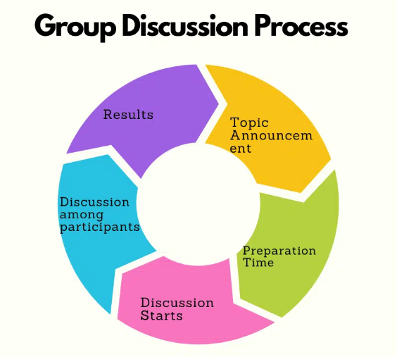

Slide 20
1. Topic Announcement
Initiation: The moderator announces the topic for discussion. This could be a factual, opinion-based, case study, or abstract topic.
Briefing: Participants receive a brief overview of the topic and any specific guidelines or rules to follow during the discussion.
2. Preparation Time
Preparation Period: Participants are usually given a few minutes (typically 3-5) to gather their thoughts, make notes, and organize their ideas.
Strategy Planning: During this time, participants can plan their strategy for the discussion, considering how to introduce points, counter arguments, and conclusions.

Slide 21
3. Discussion Starts
Commencement: The moderator signals the start of the discussion, and participants begin sharing their views.
Initial Contributions: Participants can take turns speaking, with some taking the initiative to start the discussion while others may choose to add their points.
4. Discussion Among Participants
Interaction: The core of the group discussion involves an interactive exchange of ideas among participants. This phase tests the entire group discussion in communication skills, argument, and collaboration skills.
Key Elements: Articulation: Clarity and effectiveness in presenting points. Listening: Paying attention to others’ viewpoints and responding appropriately. Leadership: Taking charge of the discussion flow without dominating it. Conflict Management: Handling disagreements constructively.

Slide 22
5. Results
Evaluation: After the discussion, the moderator or panel of judges evaluates each participant based on their performance.
Criteria: Common criteria include communication skills, content knowledge, logical reasoning, teamwork, and leadership qualities.
Feedback: In some cases, participants may receive feedback on their performance, highlighting strengths and areas for improvement.
Understanding this process helps participants prepare adequately, ensuring they can contribute effectively and make a positive impression during the group discussion round.

Slide 23
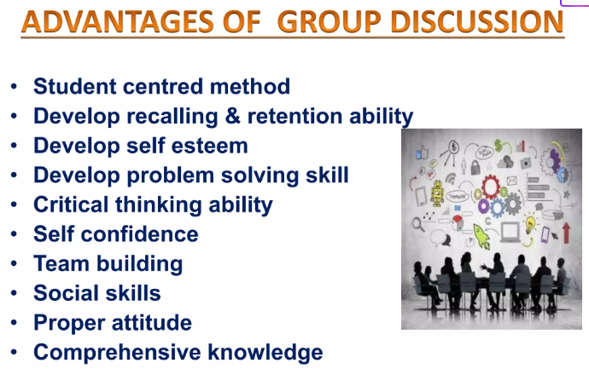

Slide 24
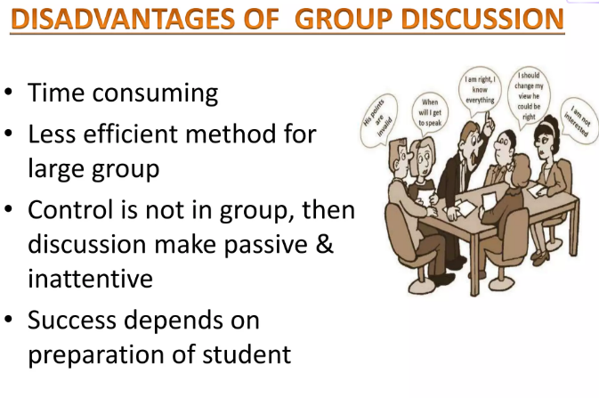

Slide 25
Importance of GD
Promotes critical thinking
Develops confidence
Encourages cooperation
Enhances knowledge through sharing

Slide 26
Importance Of Group Discussions
Here’s why GDs are essential:
Evaluate Communication Skills: Assess clarity, coherence, and effectiveness in conveying ideas.
Assess Teamwork: Determine the ability to collaborate and work cohesively with others.
Test Analytical Thinking: Test problem-solving skills and logical reasoning.
Identify Leadership Qualities: Spot potential leaders who can guide and motivate the group.
Measure Knowledge: Check awareness and understanding of relevant topics and current affairs.

Slide 27
Importance Of Group Discussions
Assess Time Management: Observe how well candidates manage and utilize their allotted time.
Evaluate Persuasiveness: See how effectively candidates can influence and convince others.
Test Adaptability: Assess flexibility in handling different viewpoints and unexpected changes.
Measure Stress Management: Evaluate how candidates handle pressure and maintain composure.
Understand Interpersonal Dynamics: Gain insights into candidates’ personalities and their ability to interact positively with others.

Slide 28
Methods of Group Discussion
Topic-Based – Factual, Controversial, Abstract topics
Case Study Based – Analyze & discuss a scenario
Role Play Based – Act as characters to solve an issue
Structured GD – Moderator guides flow of discussion

Slide 29
Skills Assessed in GD
Communication skills
Leadership & initiative
Teamwork & cooperation
Analytical thinking
Time management

Slide 30
Do’s and Don’ts
✅ Do’s: Be clear, listen actively, be respectful, use examples
❌ Don’ts: Interrupt, dominate, go off-topic, be disrespectful

Slide 31
Conclusion
Group Discussion is not about winning but about effective participation, collaboration, and idea sharing.

Slide 32
Thank You

